Slide 1
Family Forum
AMERICAN RESCUE PLAN ACT
ESSER III
Notes:
Dr. Gothard message needs to be created
Dr. Gothard message needs to be translated
Slide deck needs to be translated
Slide deck needs to be narrated in the following languages: Hmong, Karen, Spanish and Somali
-narrate by slide

Slide 2
Agenda
Welcome
Video message
Federal funding overview
Listening

Slide 3
Introduction from Dr. Gothard
Video here

Slide 4
What is the American Rescue Plan Act ?
Federal law passed March 11, 2021
American Rescue Plan Elementary and Secondary School Emergency Relief Fund -- “ARP ESSER”
One of three rounds of emergency relief funding provided to states
Goals
Safely reopen PK-12 schools
Sustain the safe operation of schools
Address the impact of the coronavirus pandemic on students

Slide 5

ESSER I in SPPS
Preventing, preparing for, and responding to COVID-19
Received $19.9 million
SPPS investments:
Technology for students to support distance learning
Material for students to use at home
PPE
Essential Kids Care
Additional custodial staffing
Interpretative services

Slide 6
ESSER II in SPPS
Reopening and operating safely
Received $92.1 million
SPPS investments:
Reading and math teachers, counselors, social workers, intervention specialists
Stabilizing staffing overall
Educator professional development
Resources for arts, science
High school credit recovery programming
Notes:
Used approximately 71M

Slide 7
ARP ESSER in SPPS
Stabilizing systems & addressing the impact of the coronavirus pandemic on students
Receiving $206.9 million
Planning:
20% must be used to address learning loss through evidence-based interventions
Consulting with stakeholders and give the public an opportunity to provide input in the development of its plan
Plan submitted to state by 10/1/2021
Notes:
The SEA will ensure that each LEA will reserve not less than 20 percent of its total ARP ESSER allocation to address learning loss through the implementation of evidence-based interventions, such as summer learning or summer enrichment, extended day, comprehensive after school programs, extended school year programs, or other evidence-based interventions, and ensure that such interventions respond to students’ academic, social, and emotional needs and address the disproportionate impact of COVID-19 on student subgroups (each major racial and ethnic group, children from low-income families, children with disabilities, English learners, gender, migrant students, students experiencing homelessness, and children and youth in foster care).

Slide 8
SPPS ARP ESSER Goals
1 | Safely reopen schools for all students
2 | Address pre and post pandemic unfinished learning
3 | Build lasting, equitable systems of teaching and learning
4 | Supporting student and staff social emotional needs on returning to full on-site learning

Slide 9
Your input is critical
Comment session agreements
We are here to listen
We won’t respond to questions
Don’t identify individual people
We are going to record the feedback and take notes
Comments here will be taken into consideration along with other sources of information
Needs Assessment Public Comment

Slide 10
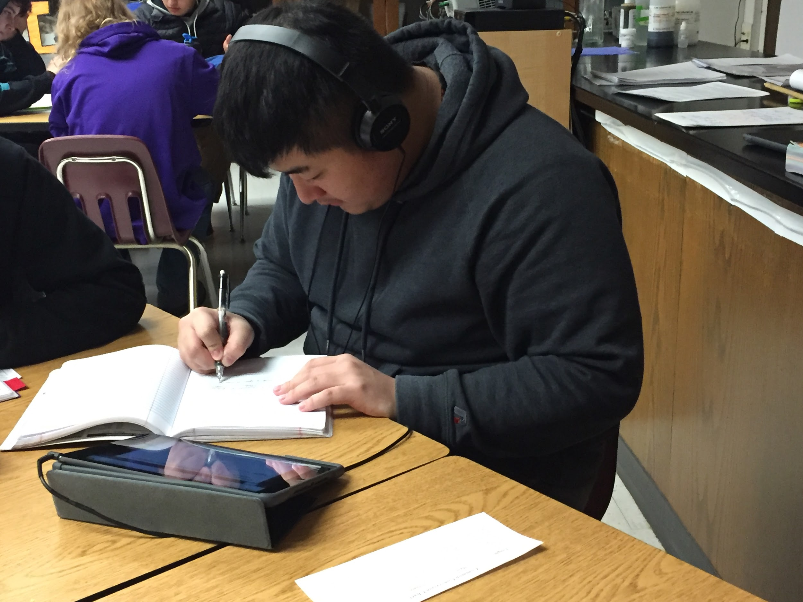
What should we know about your child/children’s needs for safe schools and classrooms?
Safely reopen schools for all students
Hallways
Cafeterias
Air quality
Ventilation
Buses
Masks

Slide 11
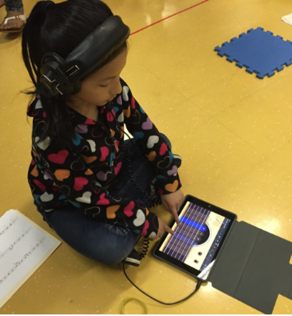
What should we know about your child/children’s needs for the lost instruction or learning time due to COVID-19?
Address pre and post pandemic unfinished learning
School day
After-school
Summer
Non-school days

Slide 12

What should we know about your child/children’s learning needs?
Build lasting, equitable systems of teaching and learning
Access to rigorous, culturally relevant curriculum
Arts, science, social studies, PE, music
Diverse teaching staff
Opportunities for internships
Variety of program options
Advanced courses
Extra curricular

Slide 13

What should we know about your child/children’s emotional well-being and happiness?
Supporting student and staff social emotional needs on returning to full on-site learning
School climate
Safety
Positive outlook
Positive identity

Slide 14
SPPS ARP ESSER Planning 2021 Timeline
May | Begin project, form workgroup
June | Needs assessment with stakeholder input Form advisory group
July | Draft priorities, investment strategies Establish outcomes and measures
August | Draft allocations and multi-year investment plan Information sessions
September | Revise and approve plan
Notes:
The SEA will ensure that each LEA will reserve not less than 20 percent of its total ARP ESSER allocation to address learning loss through the implementation of evidence-based interventions, such as summer learning or summer enrichment, extended day, comprehensive after school programs, extended school year programs, or other evidence-based interventions, and ensure that such interventions respond to students’ academic, social, and emotional needs and address the disproportionate impact of COVID-19 on student subgroups (each major racial and ethnic group, children from low-income families, children with disabilities, English learners, gender, migrant students, students experiencing homelessness, and children and youth in foster care).

Slide 15
Thank you!
Information from this session will be combined with input from other groups
The overall needs assessment report will be posted on the SPPS website in July

